Slide 1




Azure virtual network
HDInsight subnet
Zookeeper nodes
Worker nodes
Master
nodes
HADOOP
HDInsight service
gateway
Edge
node
[https]

Slide 2
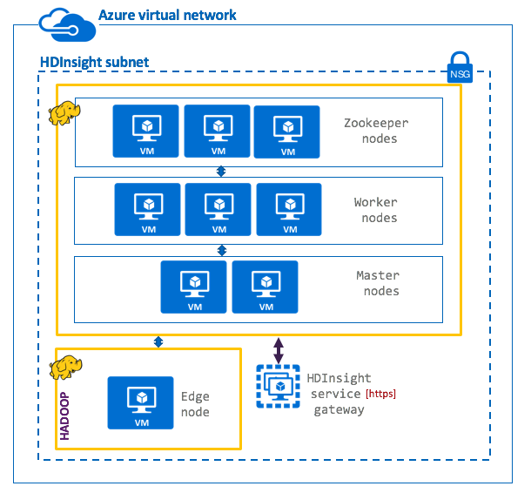
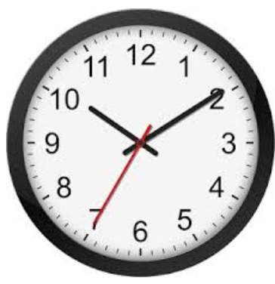
Option 1: Active-hot standby with dual ingest
Active
Hot standby
Ingest
Ingest
No replication
Process
Process
Publish
Publish
Primary datacenter
Secondary datacenter
Synchronization validation
RPO
Low/None
Applications/integration processes write to Kafka on both clusters
Both clusters run identical batch jobs and processes to consumer from Kafka
Standby cluster is offline for reads by applications and end users
Synchronization tasks need to be run to ensure clusters are in sync
RTO
Low/None
Cost
High

Slide 3
Option 2: Active- cold standby with batch replication
Active
Cold standby
Apache MirrorMaker
Ingest
Replication
Process
Publish
Primary datacenter
Secondary datacenter
Synchronization validation
Medium
RPO
Applications write to Kafka on the active-primary ONLY
Replication to DR Kafka cluster is incremental, batch, scheduled with Apache MirrorMaker
Synchronization tasks need to be run to ensure clusters are in sync
RTO
Medium
Cost
High

Slide 4


Option 3: Active-Active (bi-directional replication) with Apache MirrorMaker
Active
Active
Ingest
Ingest
Apps/users routed to nearest cluster
Process
MirrorMaker
Process
Apps/users routed to nearest cluster
MirrorMaker
Publish
Publish
Datacenter 1
Datacenter 2
Synchronization validation
RPO
Lowest/None
Applications/integration processes publish to/consume from nearest Kafka
Both clusters run identical processing
Synchronization tasks need to be run to ensure clusters are in sync
RTO
Lowest/None
Cost
High

Slide 5
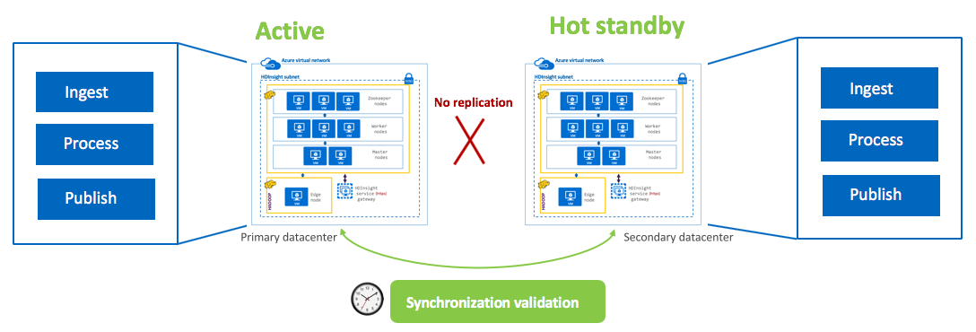
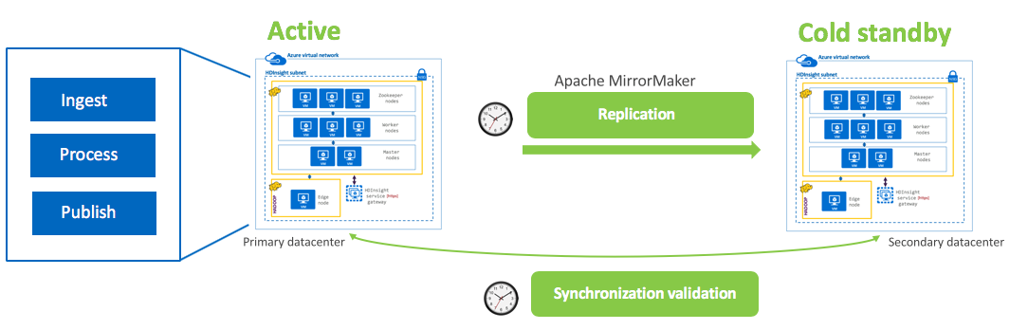
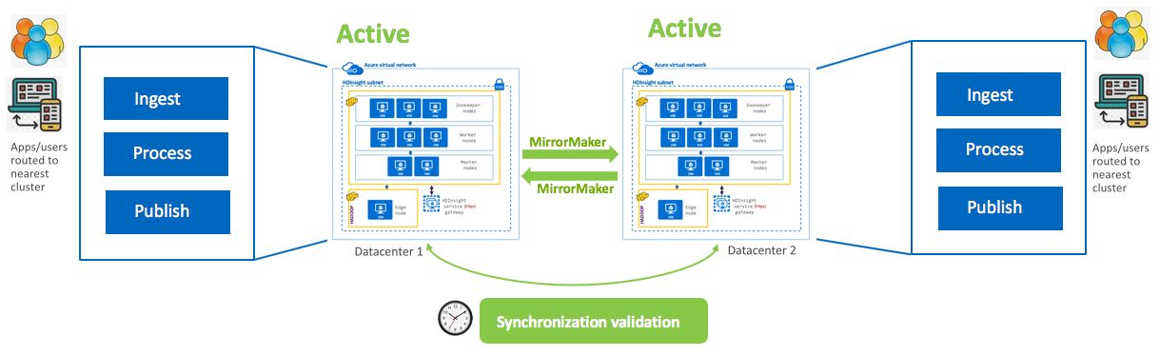
Configuration options | RPO | RTO | Cost | Effort
 | Low/ None | Low/ None | High | High
 | Medium | Medium | High | High
 | Highest | Highest | Lowest | Highest
1. Active-Hot standby with dual ingest & processing
2. Active-Cold standby with batch replication
3. Active-Active with bi-directional replication through MirrorMaker

